Slide 1

Cluster analysis Machine Learning
Richard Brooks

Slide 2
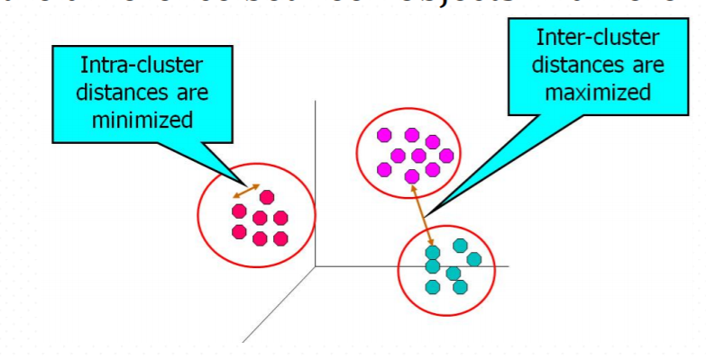
Clustering - Overview
What is cluster analysis?
Grouping data objects based only on information found in the data describing these objects and their relationships
Maximize the similarity within objects in the same group
Maximize the difference between objects in different groups

Slide 3
Clustering - Overview
What is cluster analysis?
Similarity:
Numerical measure of “alikeness” of two instances
Greater if more alike
Can be normalized to [0,1]
Dissimilarity:
How different two instances are
Lower for “alike” instances
These are usually expressed in terms of a distance function
Different weights can be assigned to different features
Hard to define what “similar enough” means
The answer is typically highly subjective.

Slide 4
Clustering - Overview
What is cluster analysis?
Different from classification (supervised learning) in that the labels for each instance are derived only from the data (inductive)
For that reason, cluster analysis is referred to as unsupervised classification

Slide 5
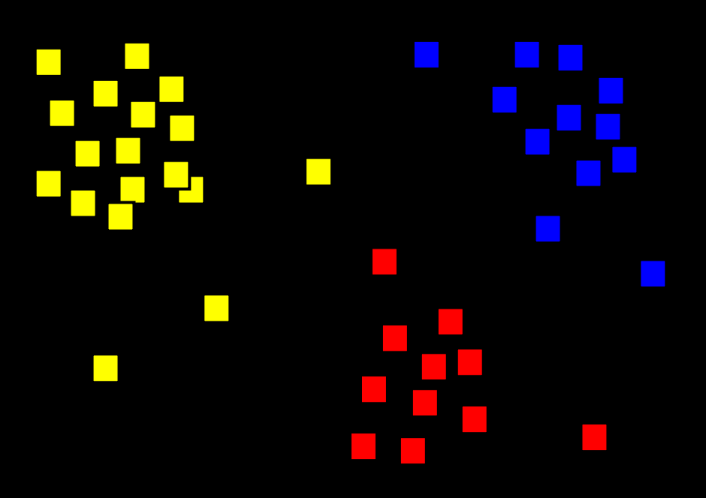
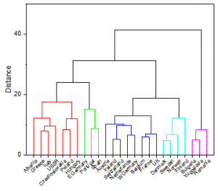
Hard clustering
Partitional clustering
Hierarchical clustering

Slide 6
K-means Clustering

Slide 7
K-means clustering
Prototype based (centroids)
Partitional clustering
User-specified number of clusters (K)

Slide 8
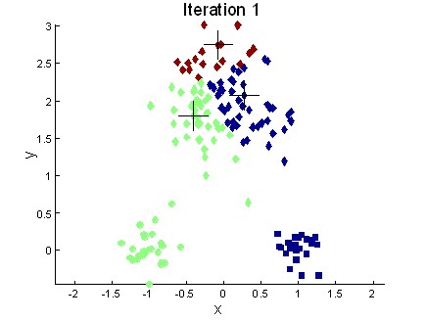
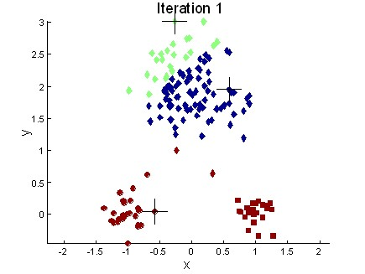
Choosing the initial centroids
Completely random
How do you think that will work?
Clusters vary from one run to another
Multiple runs
Using hierarchical clustering on a subset, taking the centroid of the K clusters
Select a high number of K and then select among these initial centroids
If there are K real clusters then the probability that you select one centroid from each cluster is small
Sometimes the initial clusters will adjust themselves the right way - sometimes they don't

Slide 9
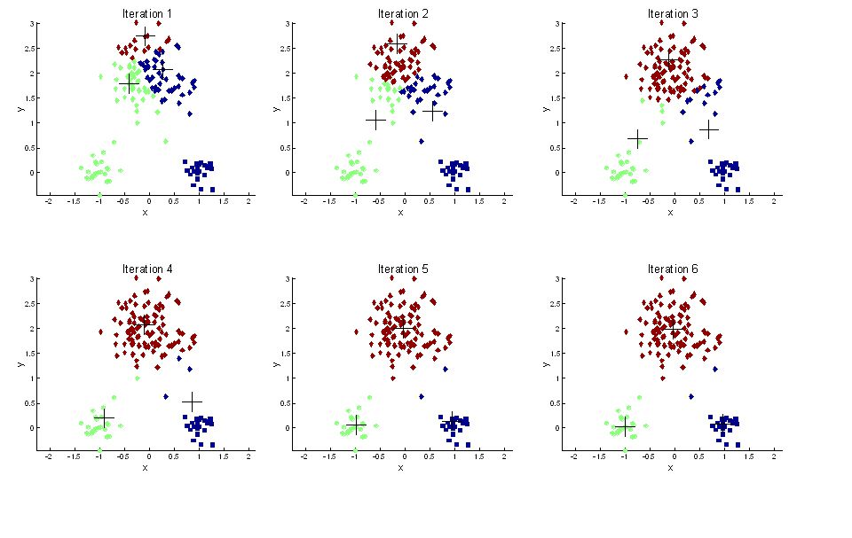
Importance of choosing the initial centroids

Slide 10
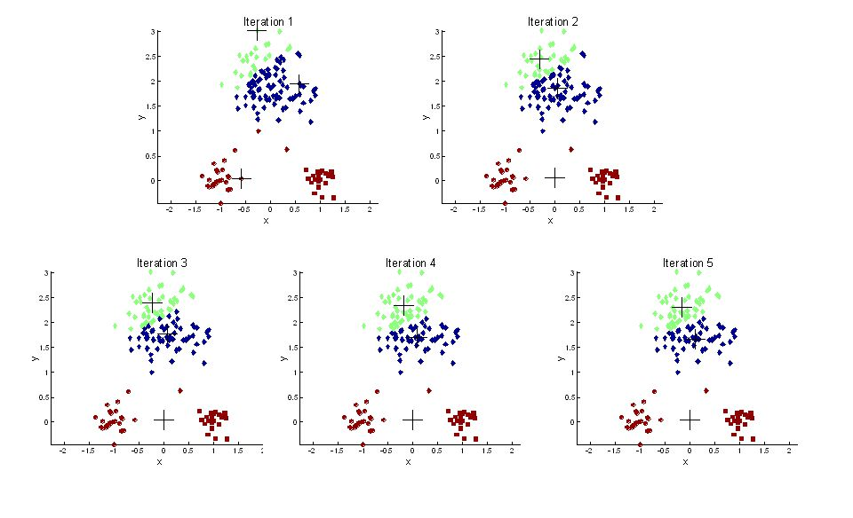
Importance of choosing the initial centroids

Slide 11
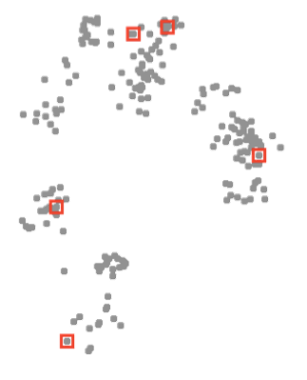
Initialization methods
Random
Usually, choose random data index
Ensures centers are near some data
Issue: may choose nearby points

Slide 12
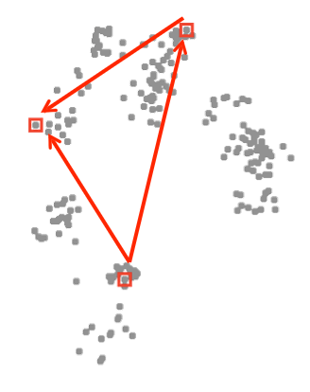
Initialization methods
Random
Usually, choose random data index
Ensures centers are near some data
Issue: may choose nearby points
Distance-based
Start with one random data point
Find the point farthest from the clusters chosen so far
Issue: may choose outliers

Slide 13
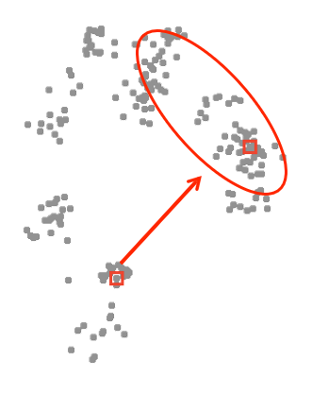
Initialization methods
Random
Usually, choose random data index
Ensures centers are near some data
Issue: may choose nearby points
Distance-based
Start with one random data point
Find the point farthest from the clusters chosen so far
Issue: may choose outliers
Random + distance (“k-means++”) (Arthur & Vassilvitskii, 2007)
Choose next points “far but randomly”
p(x) / squared distance from x to current centers
Likely to put a cluster far away, in a region with lots of data

Slide 14
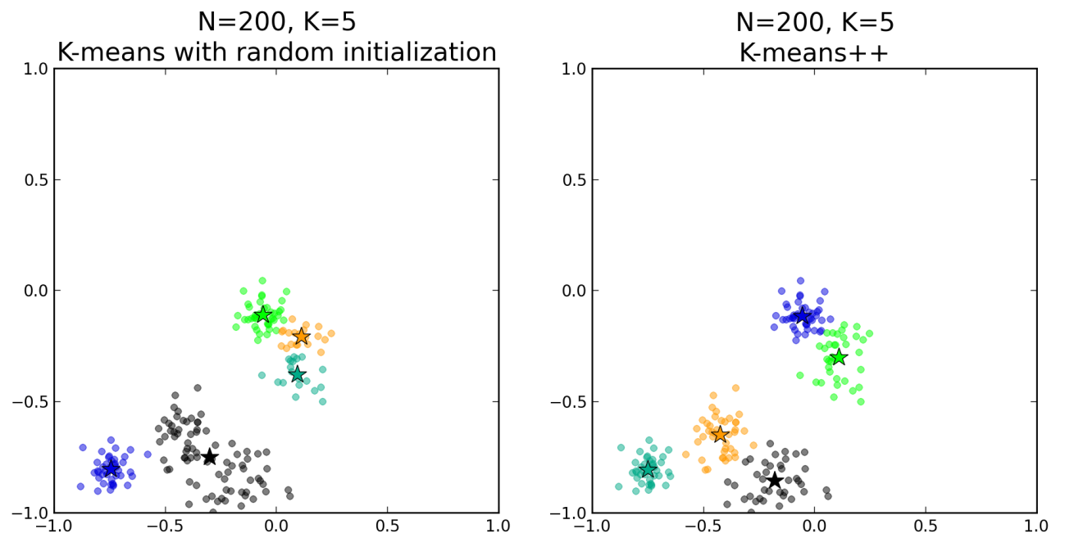
Choosing centroids with K-means++

Slide 15
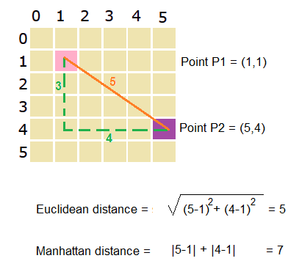
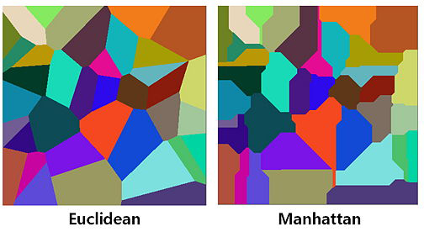
Assigning points to the closest cluster
How do you define “closest”?
Clustering with 2 different distance measures

Slide 16
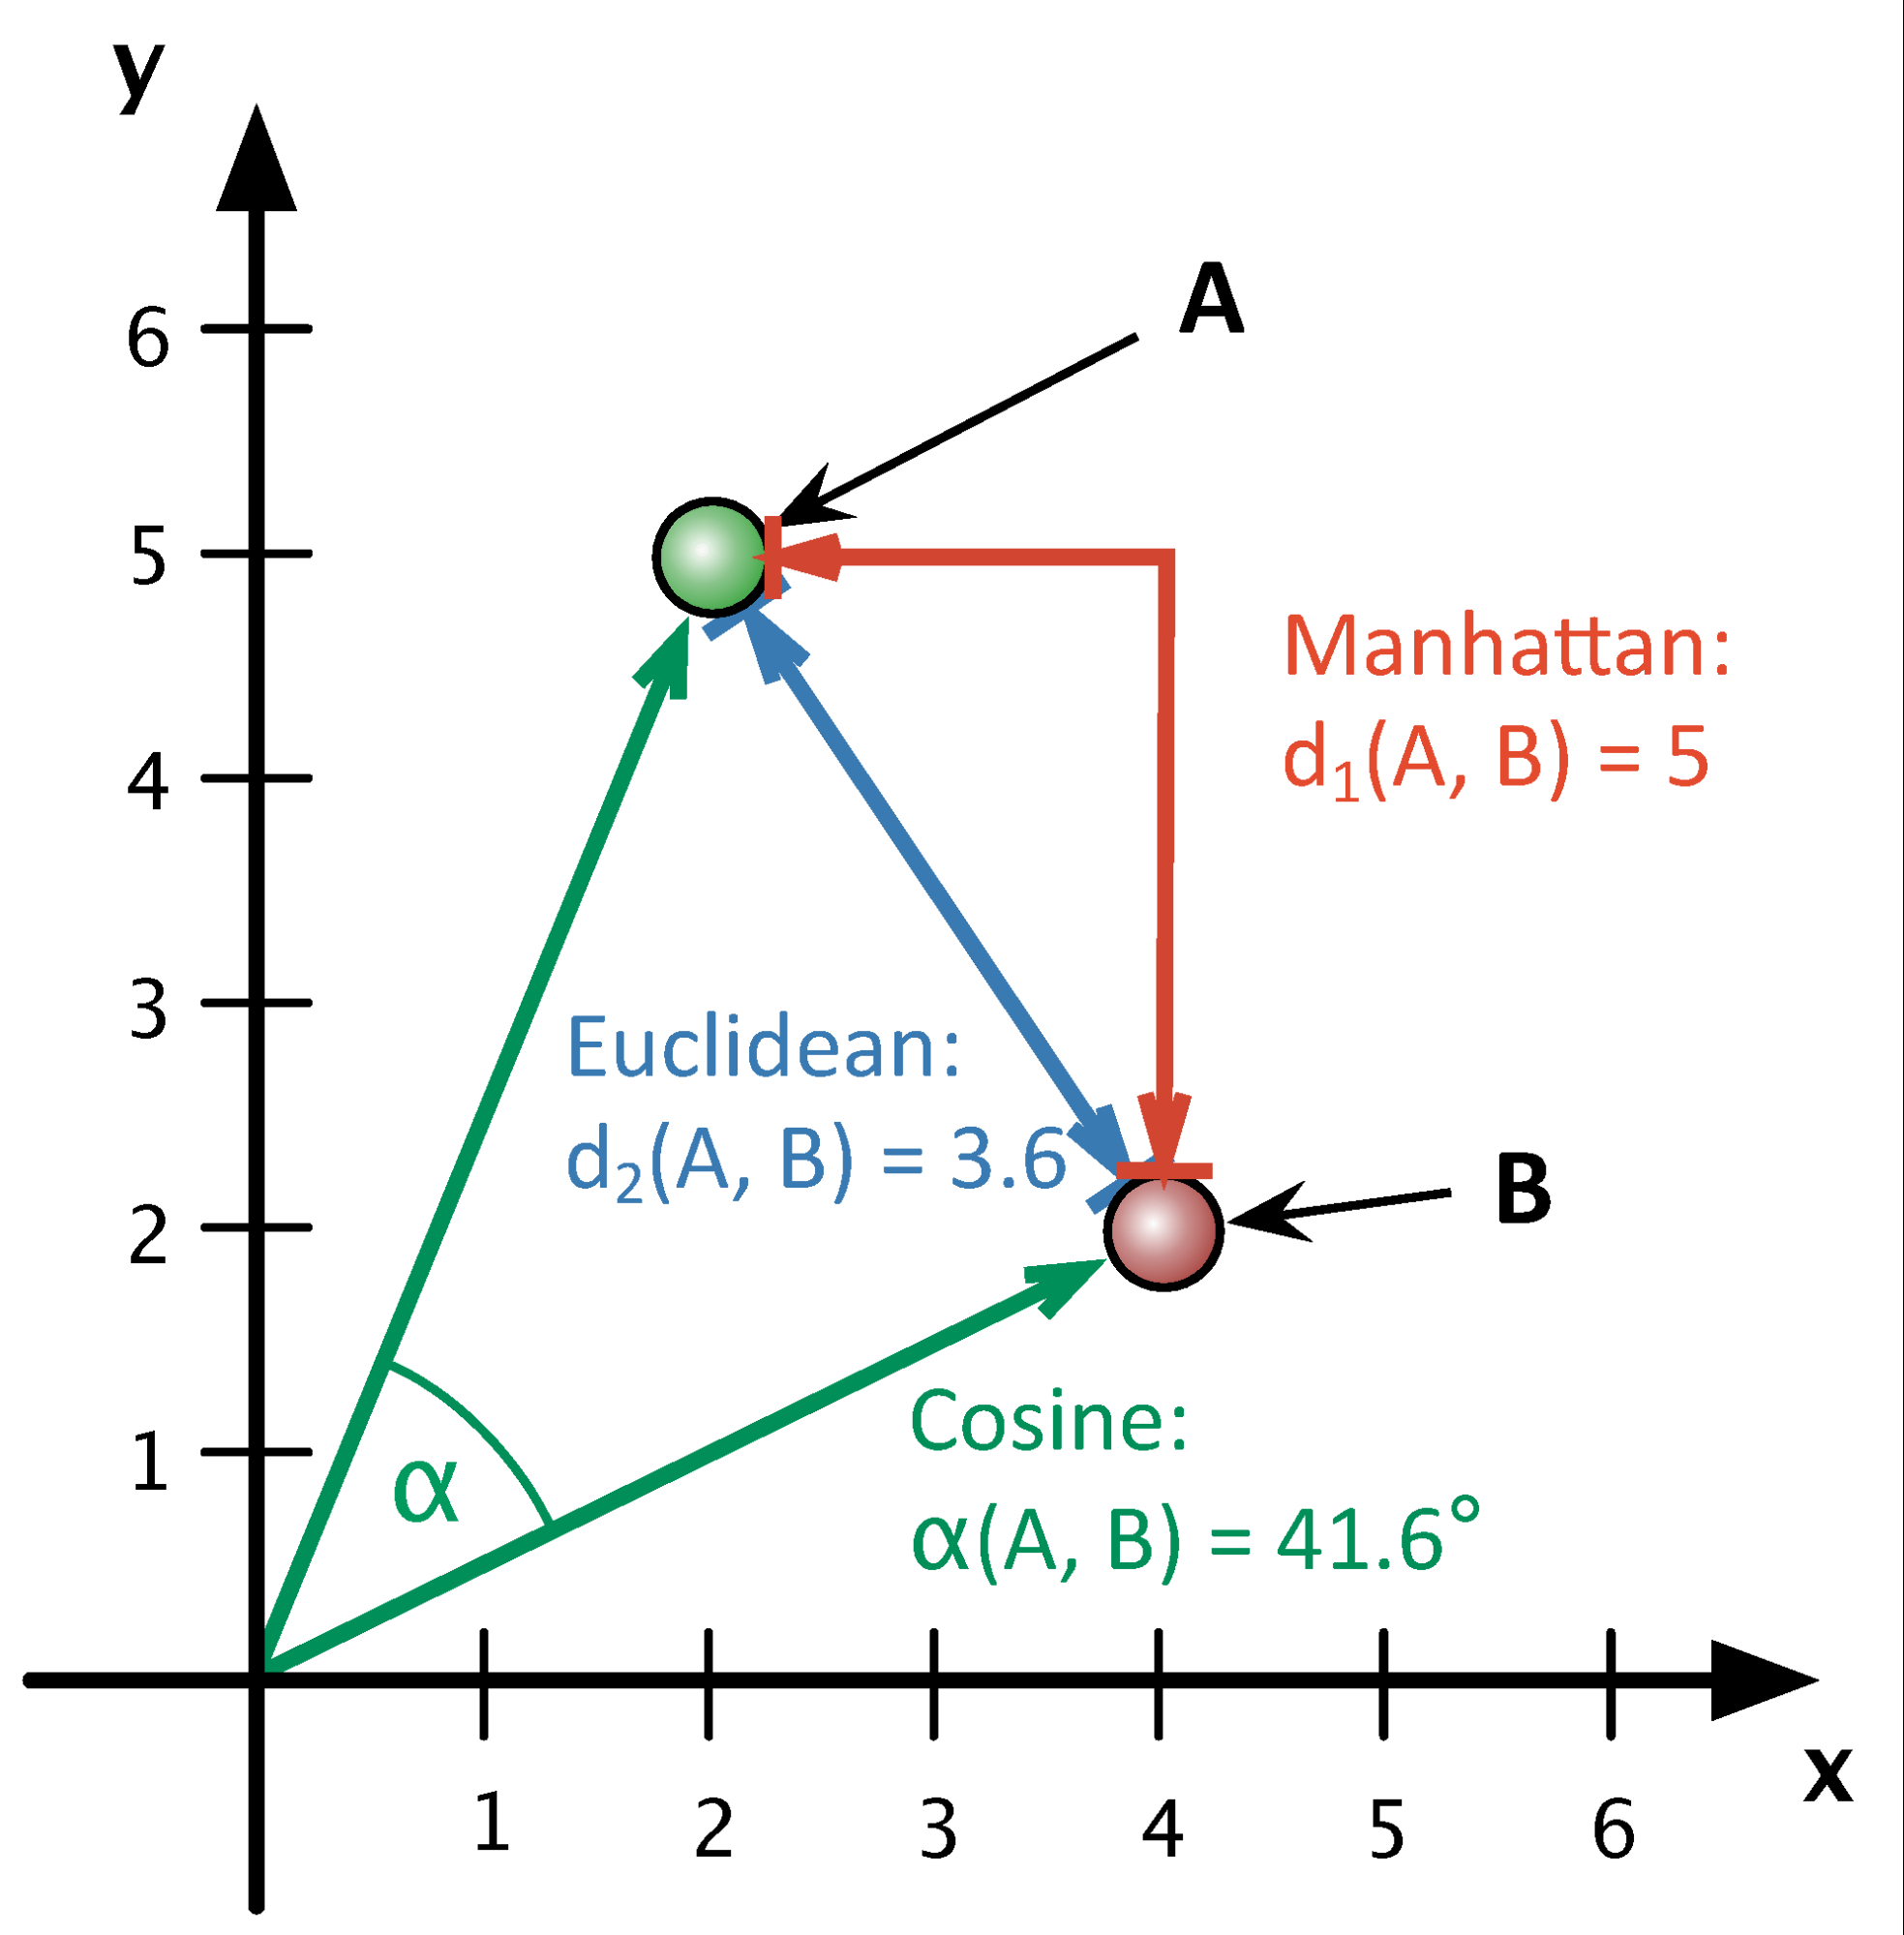
How do you choose a distance measure?
There is no simple answer to this question
The most used (and simple) distance measure is the Euclidian distance

Slide 17
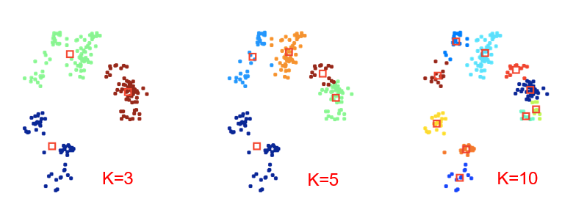
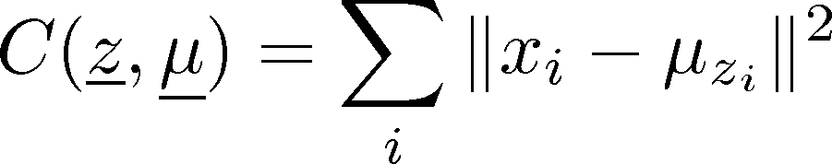
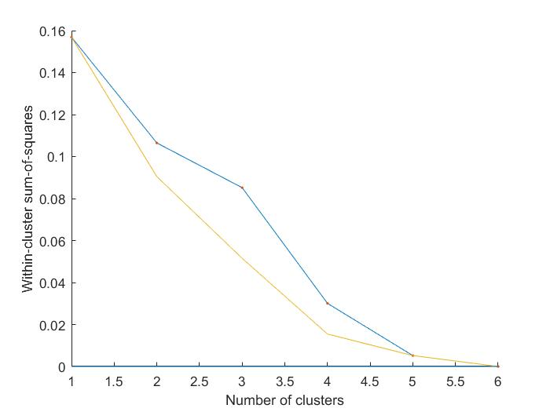
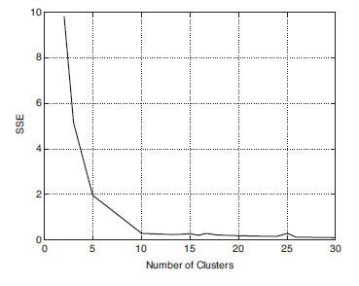
Determining the number of clusters
With cost function
what is the optimal value of k?
Cost always decreases with k!
A model complexity issue…
The “elbow” method
Compute clustering algorithm (e.g., K-means clustering) for different values of K. For instance, by varying k from 1 to 10 clusters.
For each k, calculate the total within-cluster sum of square (wss).
Plot the curve of wss according to the number of clusters k.
The location of a bend (elbow) in the plot is generally considered as an indicator of the appropriate number of clusters
Hierarchical
K-means

Slide 18
The K-means algorithm
Strengths
Weaknesses
Relatively efficient
Easy to implement and understand
Often terminate at local optimum
User need to provide input K as number of clusters (need to specify K)
Different initial K objects may produce different clustering results
Unable to handle noisy data and outliers
Not suitable for non-convex shapes
Does not apply directly to categorical data

Slide 19
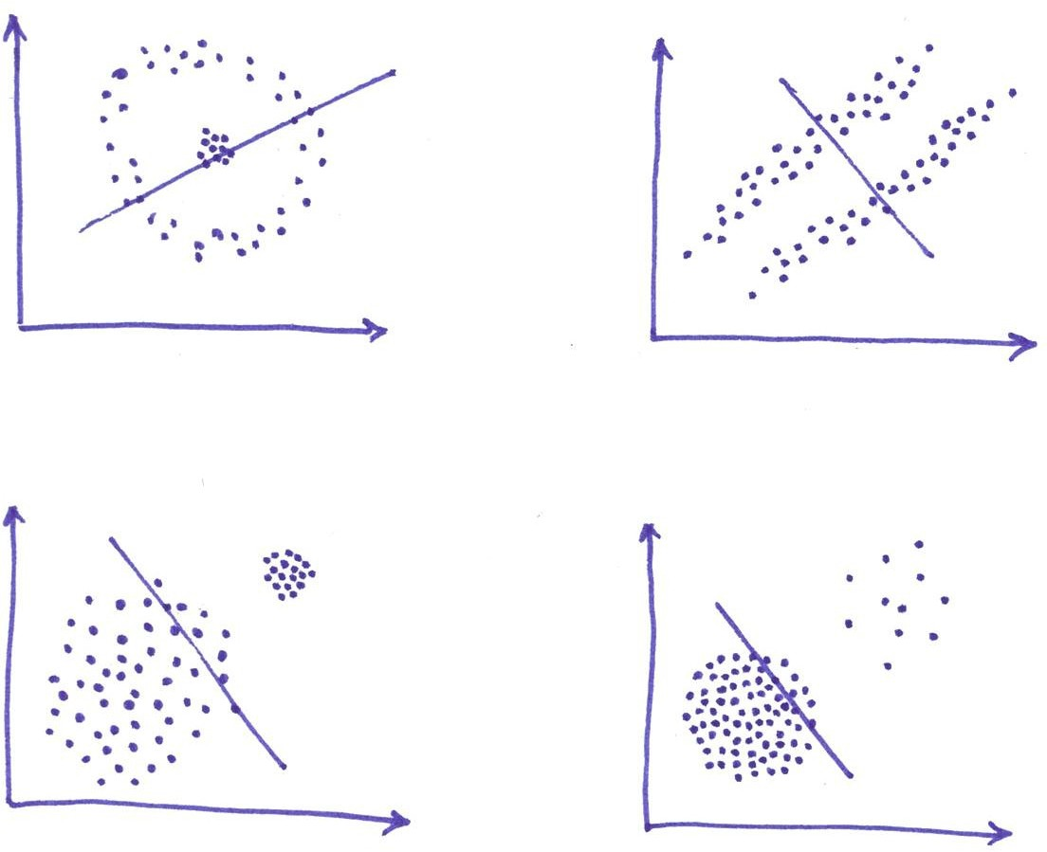
Drawbacks of K-means

Slide 20
Hierarchical clustering

Slide 21
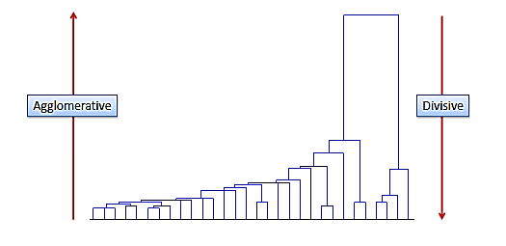
Hierarchical clustering
Agglomerative
Divisive

Slide 22
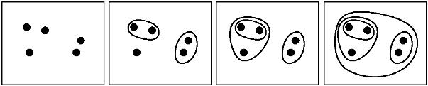
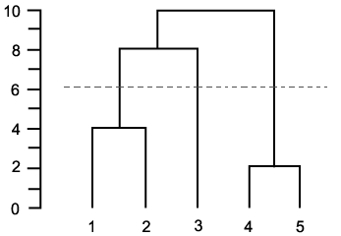
Agglomerative hierarchical clustering
Algorithm
Compute the proximity matrix if necessary
REPEAT
Merge the closest two clusters
Update the proximity matrix to reflect the proximity between the new cluster and the original clusters
UNTIL only one cluster remains

Slide 23
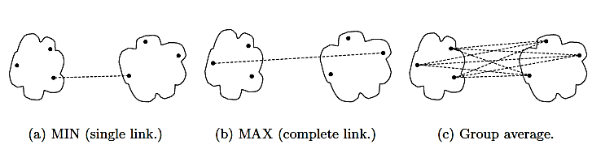
The proximity between clusters
MIN (single link):
the proximity between the two closest points
MAX (complete link):
the proximity between the farthest two points
GROUP AVERAGE:
the average pairwise proximities from all pairs of points from different clusters

Slide 24
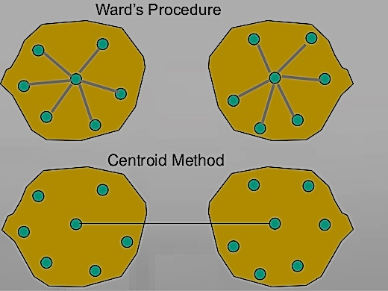
The proximity between clusters
Ward’s method:
A variation of the centroid method
The proximity between centroids is determined as an increase of SSE
Minimizing SSE (like K-means)
Ward’s method
Centroid method
Centroid method:
Prototype based view
The proximity between cluster centroids

Slide 25
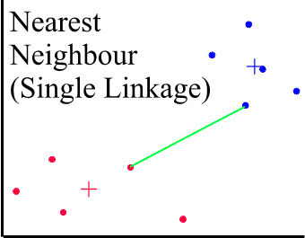
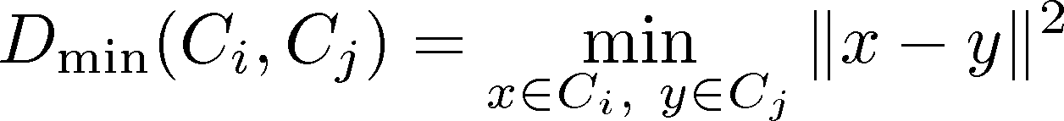
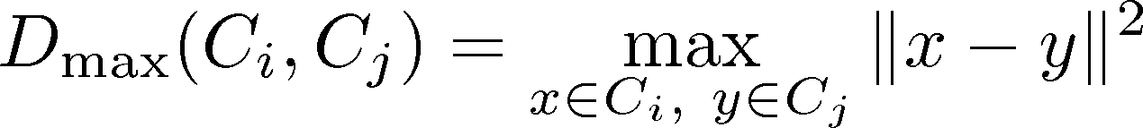
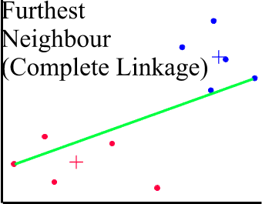
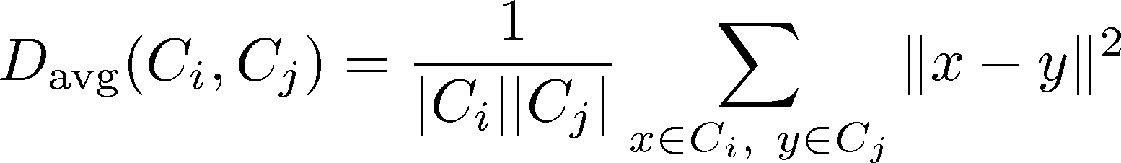
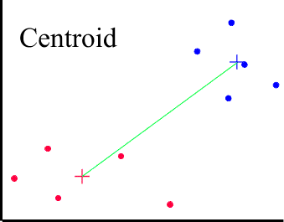
Cluster distances
produces minimal spanning tree.
avoids elongated clusters.
Need: D(A,C)
D(B,C)
D((A, B),C)

Slide 26
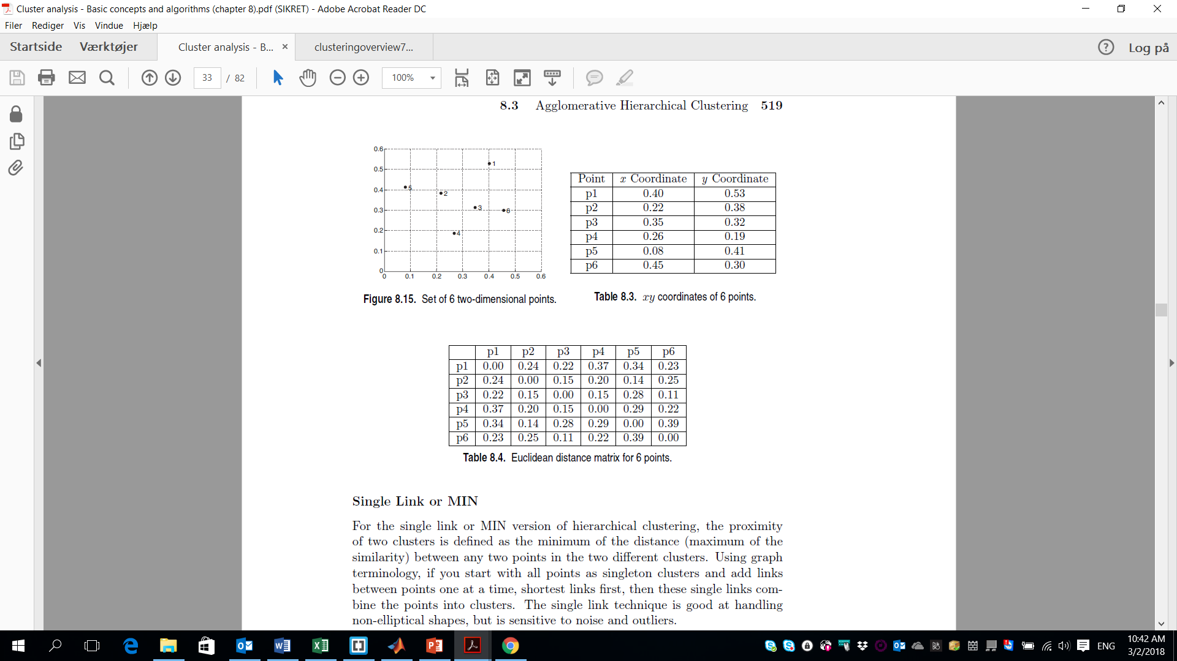
Examples
The data
Euclidean distance matrix

Slide 27
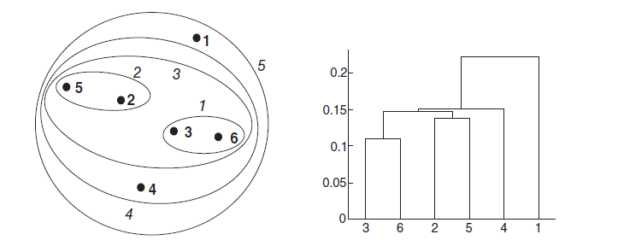
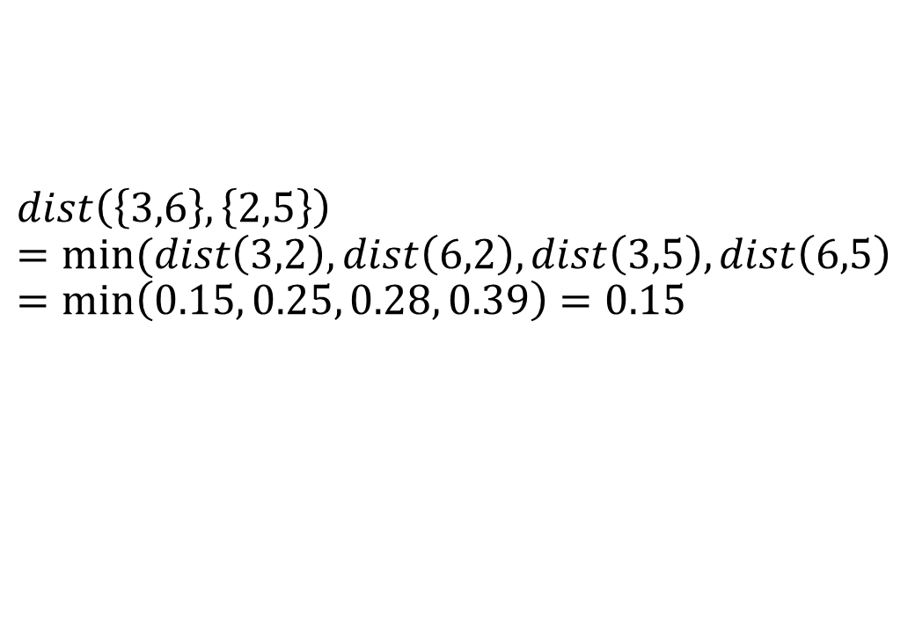
Single link method (MIN)
Euclidean distance matrix
$$dist\left(\left\{3,6\right\},\left\{2,5\right\}\right)=min⁡(dist\left(3,2\right), dist\left(6,2\right), dist\left(3,5\right), dist\left(6,5\right)=min\left(0.15, 0.25, 0.28, 0.39\right)=0.15$$

Slide 28
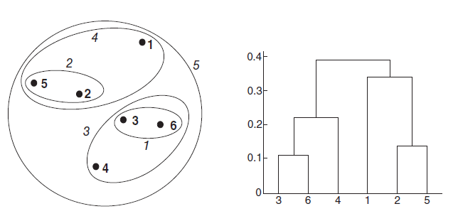
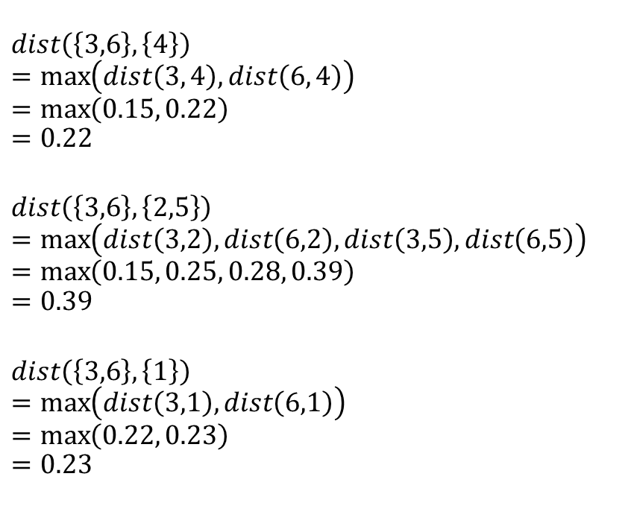
Complete link method (MAX)
Euclidean distance matrix
$$dist\left(\left\{3,6\right\}, \left\{4\right\}\right)$$
$$=\max\left(dist\left(3, 4\right),dist\left(6, 4\right)\right)$$
$$=\max\left(0.15, 0.22\right)$$
$$=0.22$$
$$dist\left(\left\{3,6\right\},\left\{2,5\right\}\right)=\max\left(dist\left(3,2\right), dist\left(6,2\right), dist\left(3,5\right), dist\left(6,5\right)\right)=\max\left(0.15, 0.25, 0.28, 0.39\right)$$
$$=0.39$$
$$dist\left(\left\{3,6\right\}, \left\{1\right\}\right)$$
$$=\max\left(dist\left(3,1\right), dist\left(6,1\right)\right)$$
$$=\max\left(0.22, 0.23\right)$$
$$=0.23$$

Slide 29
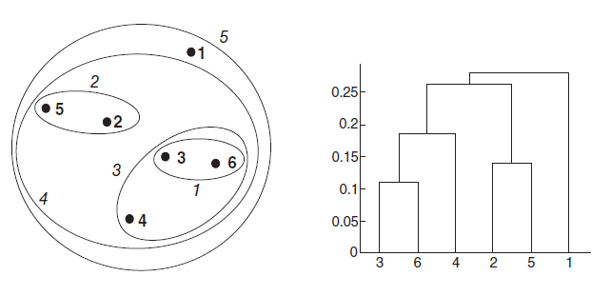
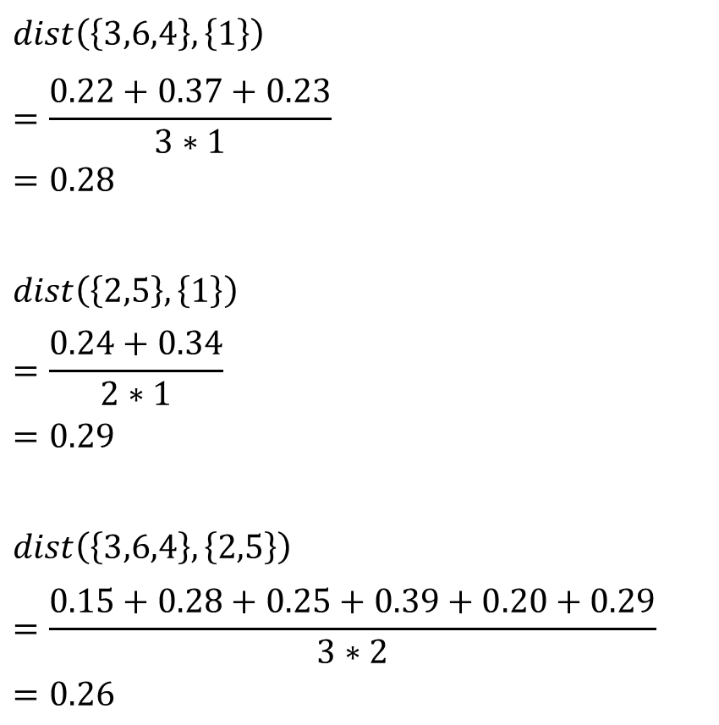
Group average
$$dist\left(\left\{3,6,4\right\},\left\{1\right\}\right)$$
$$=\frac{0.22+0.37+0.23}{3∗1}$$
$$=0.28$$
$$dist\left(\left\{2,5\right\},\left\{1\right\}\right)$$
$$=\frac{0.24+0.34}{2∗1}$$
$$=0.29$$
$$dist\left(\left\{3,6,4\right\},\left\{2,5\right\}\right)$$
$$=\frac{0.15+0.28+0.25+0.39+0.20+0.29}{3∗2}$$
$$=0.26$$
Euclidean distance matrix

Slide 30
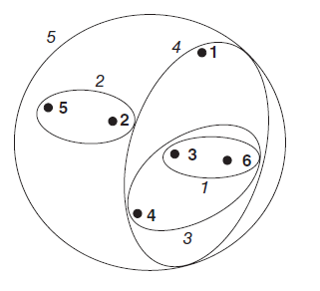
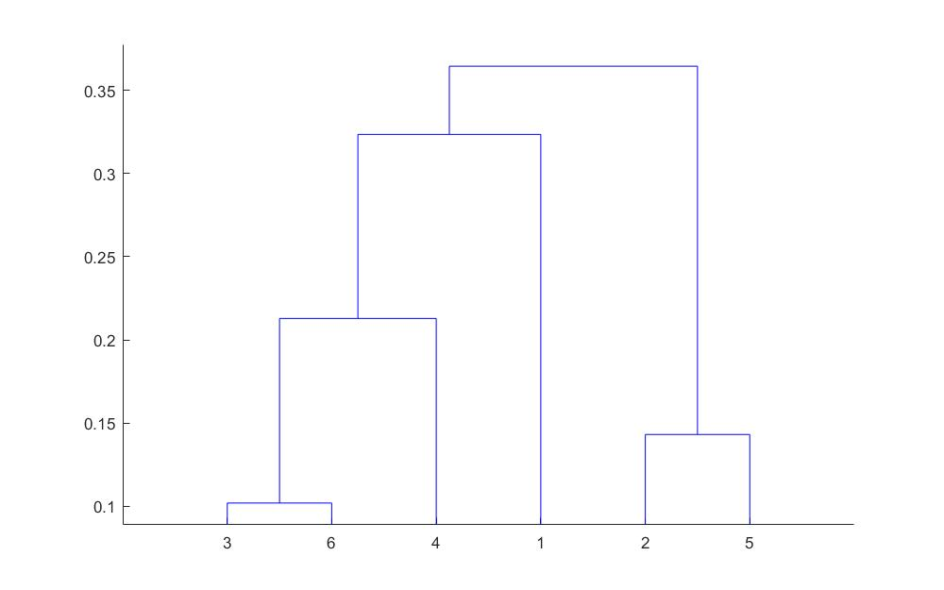
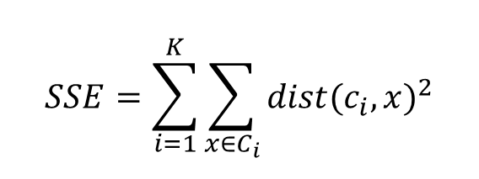
Ward’s method
Sum of the Squared Error (SSE)
$$SSE=\sum_{i=1}^{K}{\sum_{x∈C_{i}}{{dist(c_{i},x)}^{2}}}$$
Cluster 1 | Cluster 2 | SSE
3 | 6 | 0.1
2 | 5 | 0.14
4 | 7 | 0.21
1 | 9 | 0.32
8 | 10 | 0.36

Slide 31
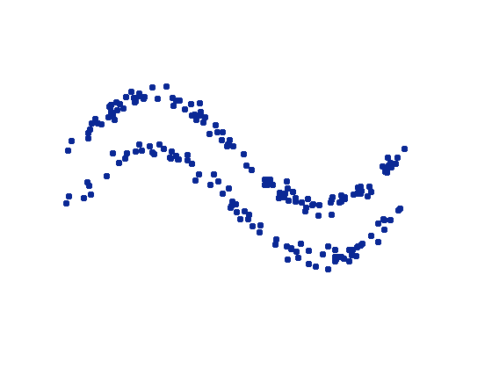
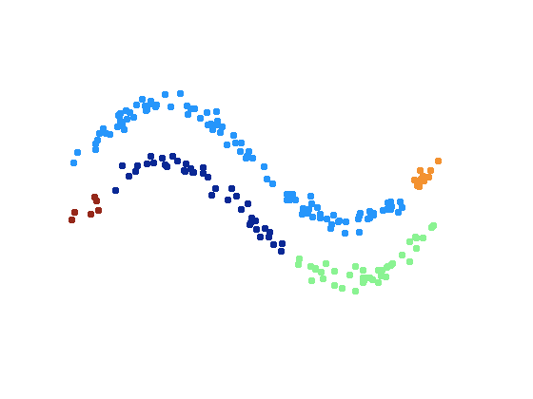
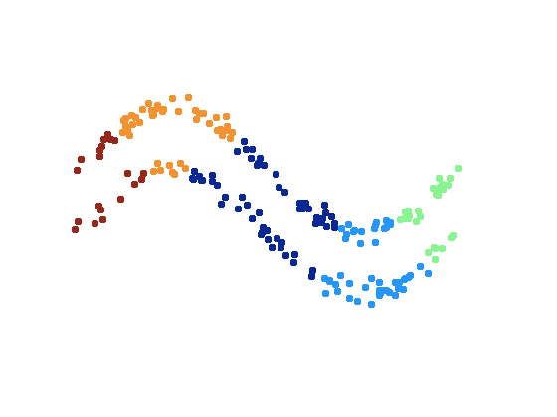
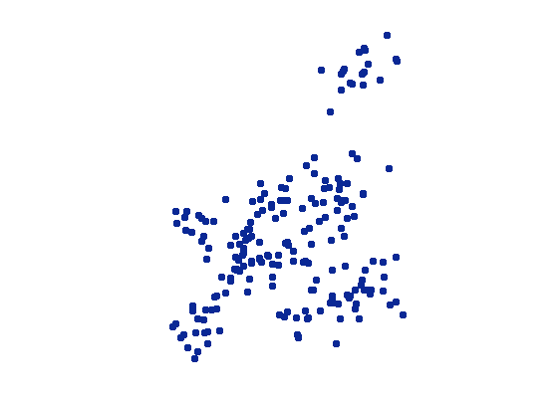
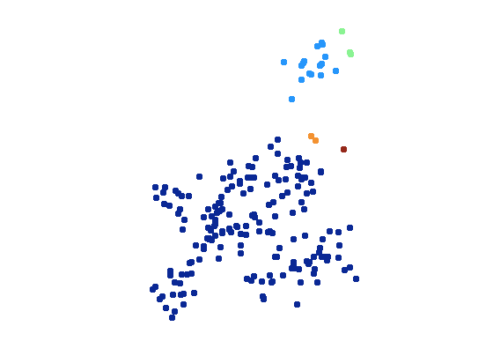
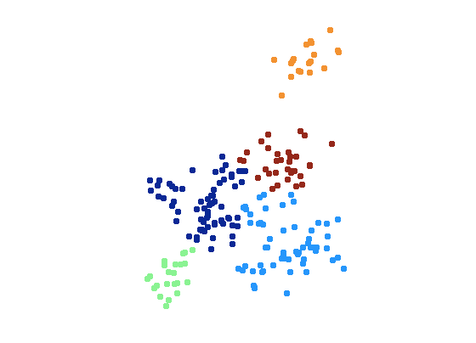
Cluster distances
Dissimilarity choice will affect clusters created
Single linkage (min)
Complete linkage (max)

Slide 32
Determining the number of clusters
Observing the dendrogram
You determine what you want to find

Slide 33
The agglomerative clustering algorithms
Strengths
Weaknesses
No apriori information about the number of clusters required
Easy to implement and gives best result in some cases
Gives consistent results with multiple runs (with the same proximity measure)
Algorithm can never undo what was done previously
Heavy in computational load and memory
Based on the type of distance matrix chosen for merging different algorithms can suffer with one or more of the following
Sensitivity to noise and outliers (single link)
Breaking large clusters (complete link)
Difficulty handling different sized clusters and convex shapes (Ward’s method)
No objective function is directly minimized
Sometimes it is difficult to identify the correct number of clusters by the dendogram

Slide 34
DBSCAN

Slide 35
DBSCAN: Density-Based Clustering
In density based clustering we partition points into dense regions separated by not-so-dense regions.
Important Questions:
How do we measure density?
What is a dense region?
DBSCAN:
Density at point p: number of points within a circle of radius Eps
Dense Region: A circle of radius Eps that contains at least MinPts points

Slide 36
DBSCAN
Characterization of points
A point is a core point if it has more than a specified number of points (MinPts) within Eps
These points belong in a dense region and are at the interior of a cluster
A border point has fewer than MinPts within Eps, but is in the neighborhood of a core point.
A noise point is any point that is not a core point or a border point.

Slide 37
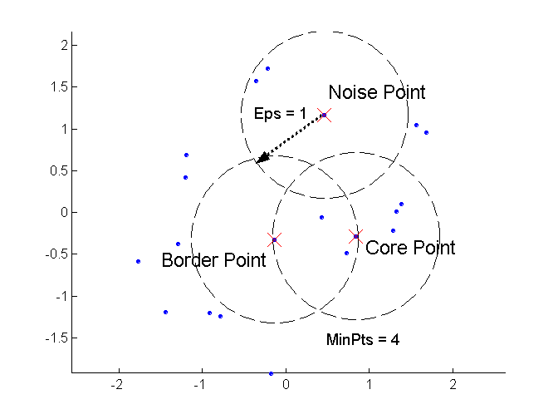
DBSCAN: Core, Border, and Noise Points

Slide 38
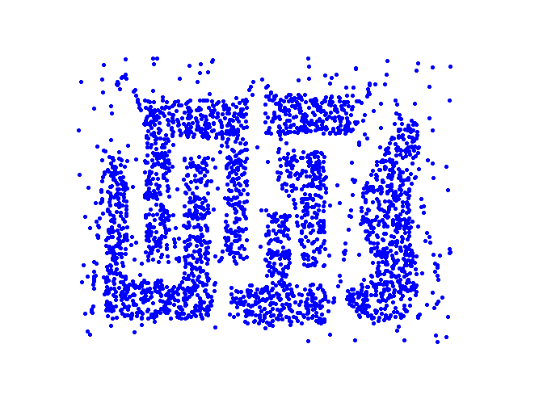
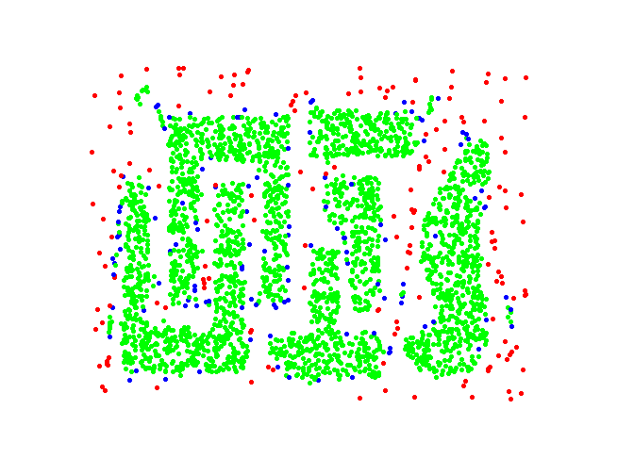
DBSCAN: Core, Border and Noise Points
Point types: core, border and noise
Original Points
Eps = 10, MinPts = 4

Slide 39
Density-Connected points
Density edge
We place an edge between two core points q and p if they are within distance Eps.
Density-connected
A point p is density-connected to a point q if there is a path of edges from p to q
p
p₁
q
p
q
o

Slide 40
DBSCAN Algorithm
Label points as core, border and noise
Eliminate noise points
For every core point p that has not been assigned to a cluster
Create a new cluster with the point p and all the points that are density-connected to p.
Assign border points to the cluster of the closest core point.

Slide 41
DBSCAN: Determining MinPts and Eps
MinPts
For two-dimensional data: use default value of minPts=4
For more than 2 dimensions: minPts=2*dim
Eps
Plot the k-distances with k=minPts (Ester et al., 1996)
Find the 'elbow' in the graph--> The k-distance value is your Epsilon value.

